Slide 1
Startup Funding Insights Dashboard
- Submitted by
Korlimarla Sreevalli Sai Keerthi
Damarouthu Vaisalya
Chakka Gowri Sai Kalki

Slide 2
Contents
Title
Introduction
Problem Statement
Objectives
Tools &Technologies
Dataset Overview
Visualizations
Key Insights
Conclusion

Slide 3
INTRODUCTION
Startup funding is the financial support provided by investors to help startups develop, expand, and achieve business growth.
As startup investments continue to increase, analyzing funding data manually becomes difficult.
This project uses Microsoft Power BI to transform startup funding data into interactive dashboards and meaningful visualizations. It provides insights into Total Funding, Top Investors, Top Funded Startups, Industry-wise Funding, Funding Types, and Key Performance Indicators (KPIs), enabling users to understand investment trends and make data-driven decisions.

Slide 4
PROBLEM STATEMENT
Startup funding data is continuously growing, making it difficult to analyze investment trends using raw data. Identifying top investors, highly funded startups, industry-wise funding distribution, and funding patterns manually is time-consuming and inefficient. There is a need for an interactive Power BI dashboard that transforms raw funding data into clear visual insights, enabling faster analysis and better decision-making.
The dashboard provides a centralized view of startup funding information through interactive visualizations.
It helps users identify investment patterns, funding stages, and industry performance more efficiently.

Slide 5
OBJECTIVES
To analyze startup funding data using Microsoft Power BI.
To identify top investors and top funded startups.
To analyze industry-wise funding distribution and funding types.
To monitor key metrics such as Total Funding, Total Deals, Average Deal Size, and Total Investors.
To present startup funding insights through interactive dashboards and visualizations.
To support data-driven decision-making for entrepreneurs, investors, and business analysts.

Slide 6
Tools & Technologies
Tool / Technology | Purpose
Microsoft Power BI | Dashboard creation and data visualization
Power Query | Data cleaning and transformation
DAX (Data Analysis Expressions) | Creating calculated measures and KPIs
Microsoft Excel / CSV Dataset | Source of startup funding data
Data Modeling | Creating relationships between data tables
Charts & KPI Cards | Visual representation of funding insights

Slide 7
DATASET
The dataset contains information about startup funding activities, including Startup Name, Industry, Investor Name, Funding Amount, Funding Type, Deal Date, and Investment Details. The data was cleaned and transformed using Power Query before being loaded into Power BI for analysis and visualization. This dataset is used to identify funding trends, investor activity, industry-wise investments, and startup performance.
Dataset Fields
Startup Name
Industry
Investor Name
Funding Amount
Funding Type

Slide 8
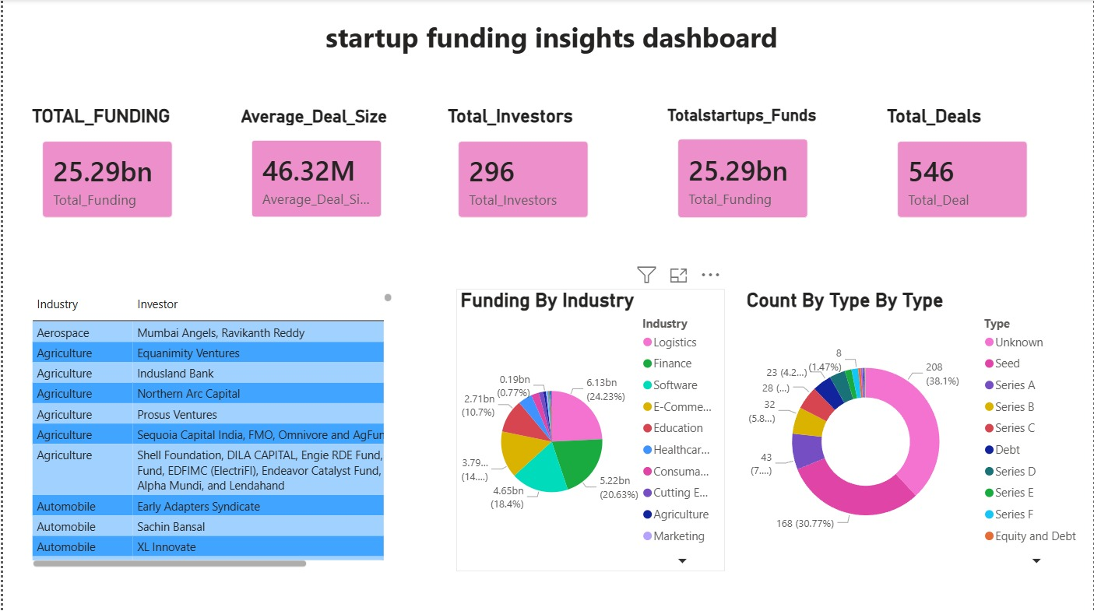
Dashboard Overview
The Startup Funding Insights Dashboard provides an interactive overview of startup investment data through KPIs and visualizations. It enables users to analyze funding trends, identify top investors and funded startups, compare industry-wise funding, and understand funding type distribution.

Slide 9
VISUALISATIONS
KPI Cards
Display Total Funding, Average Deal Size, Total Investors, Total Startup Funds, and Total Deals for a quick summary.
Table Visual
Displays Industry and Investor details for detailed data analysis.
Pie Chart
Shows Funding by Industry, helping identify industries that received the highest investments.
Donut Chart
Represents the distribution of Funding Types, such as Seed, Series A, Series B, Series C, and other funding stages.

Slide 10
KEY INSIGHTS
Total Funding reached 25.29 Billion, indicating significant startup investments.
296 unique investors participated in funding 546 startup deals.
The average deal size is 46.32 Million, showing the average investment per funding round.
The Logistics industry received the highest share of funding compared to other industries.
Seed Funding is the most common funding stage, followed by Series A and Series B.

Slide 11
CONCLUSION
The Startup Funding Insights Dashboard effectively analyzes startup investment data using Microsoft Power BI. It provides clear insights into funding trends, top investors, industry-wise funding, and key performance metrics through interactive visualizations. The dashboard supports faster analysis and helps users make informed, data-driven decisions.

Slide 12
𝑻𝒉𝒂𝒏𝒌 𝒀𝒐𝒖

